Slide 1






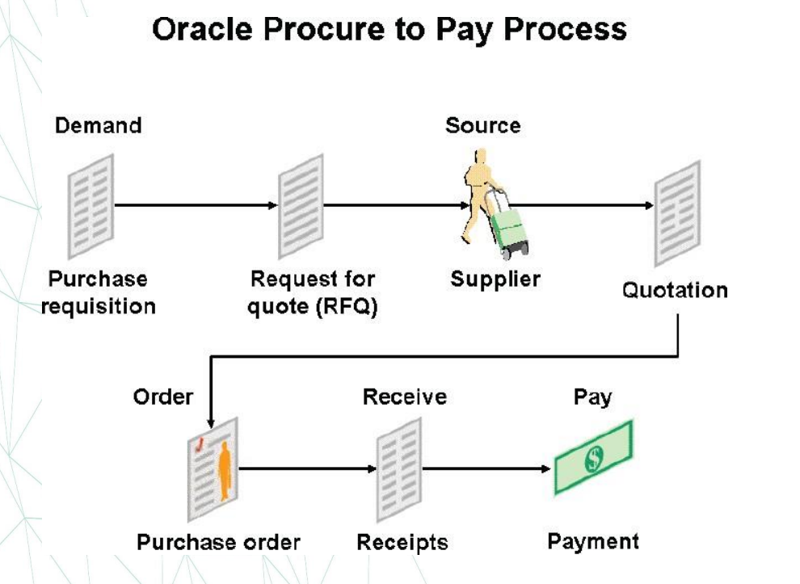
3rd Millstone
Procurement steps Implementation:
Testing and implementation
Purchase Requisition Creation
Define Buyers and Suppliers
RFQ and Quotations
Purchase Order Creation
(Direct/Requisition/Blanket Release)
Issuance of PO
Supply planning Method (MIN - MAX)
Approved Supplier list
Material Receipt
Conduct User Acceptance Testing (UAT) and actual implementation to ensure all configurations function as expected.

Slide 2
3rd Millstone
Testing and implementation
Purchase Requisition

Slide 3
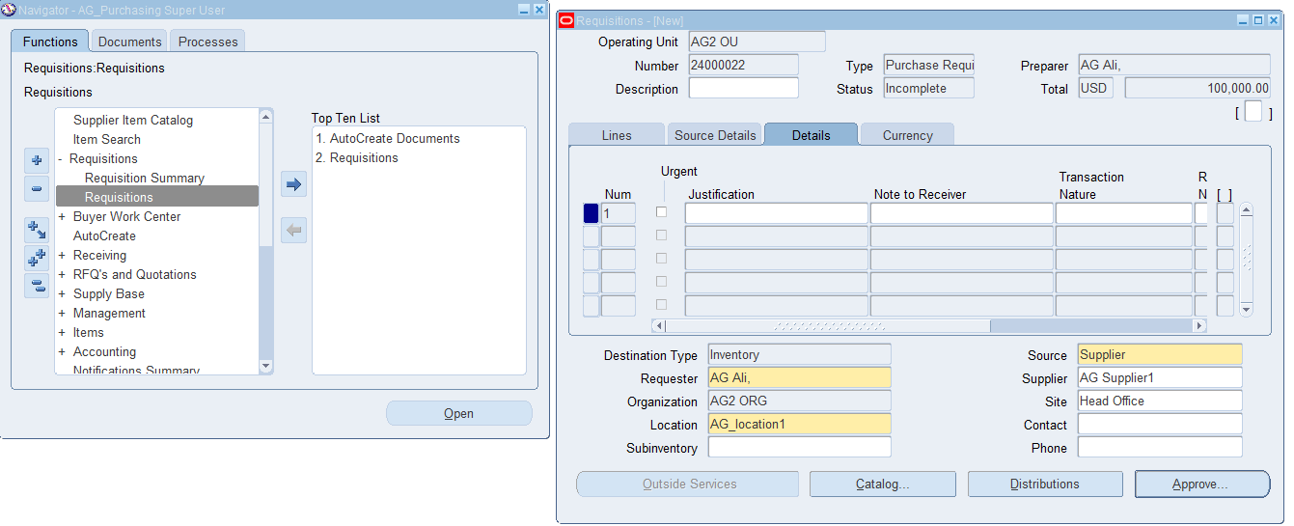
3rd Millstone
Testing and implementation
Create Purchase Requisition
AG_Purchasing SuperUser (Resp.)
Requisition → Requisitions

Slide 4
3rd Millstone
Testing and implementation
Purchase Requisition Summary

Slide 5
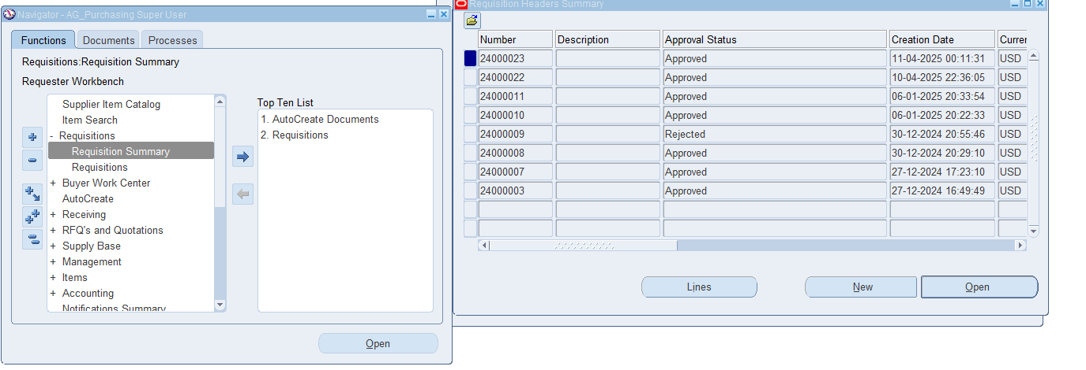
3rd Millstone
3rd Millstone
Testing and implementation
Create Purchase Requisition
AG_Purchasing SuperUser (Resp.)
Requisition → Requisition Summary

Slide 6
3rd Millstone
Testing and implementation
Define Buyer

Slide 7
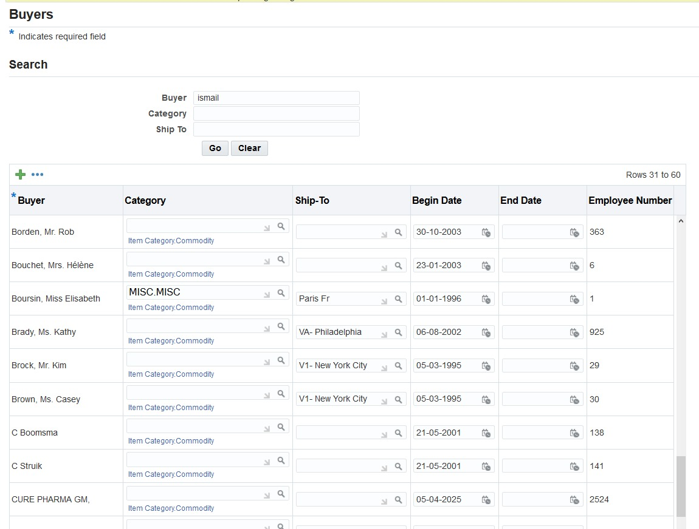
3rd Millstone
Testing and implementation
Create Buyer
AG_Purchasing SuperUser (Resp.)
Setup → Personnel → Buyer

Slide 8
3rd Millstone
Testing and implementation
Define Supplier

Slide 9
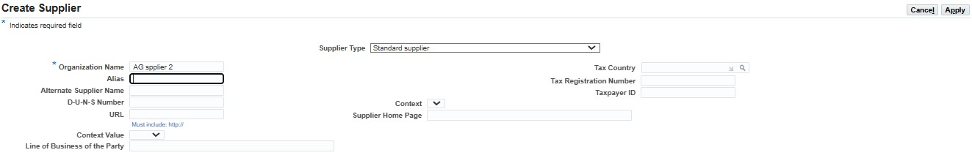
3rd Millstone
Testing and implementation
Create Supplier
AG_Purchasing SuperUser (Resp.)
Supplier base → supplier

Slide 10
3rd Millstone
Testing and implementation
RFQs and Quotations

Slide 11
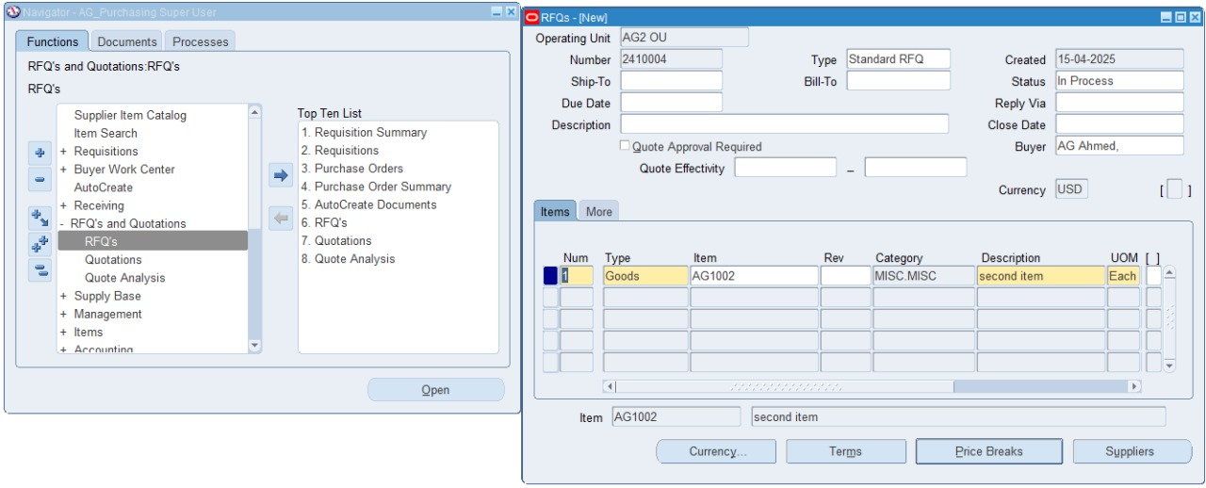
Configuration
2nd Millstone
RFQs
AG_Purchasing Super User (Resp.)
RFQs and Quotations → RFQs

Slide 12
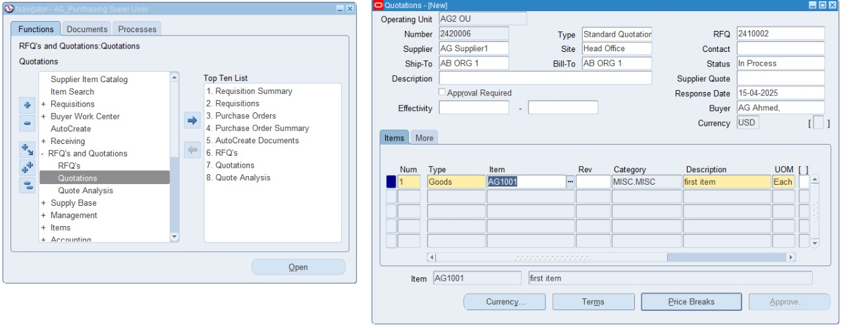
Configuration
2nd Millstone
Quotations
AG_Purchasing Super User (Resp.)
RFQs and Quotations → Quotation

Slide 13
2nd Millstone
Testing and implementation
Purchase Order

Slide 14
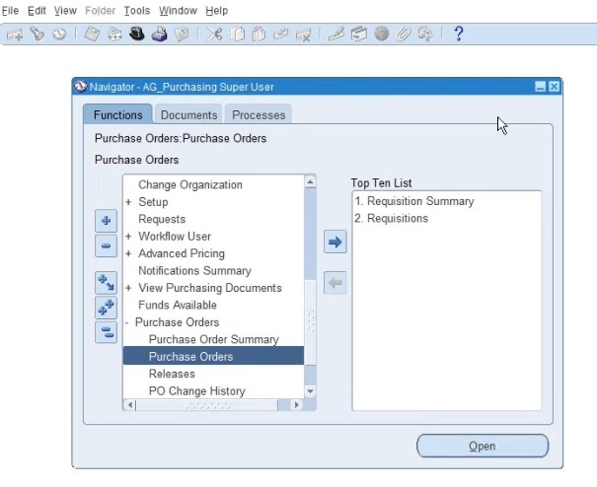
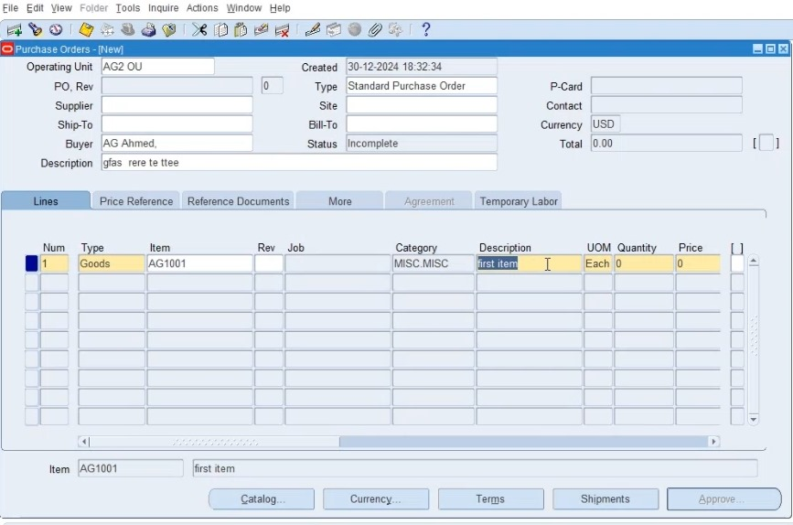
Configuration
2nd Millstone
Create Purchase Order
Direct Purchase Order
AG_Purchasing Super User (Resp.)
Purchase Order → Purchase Order

Slide 15
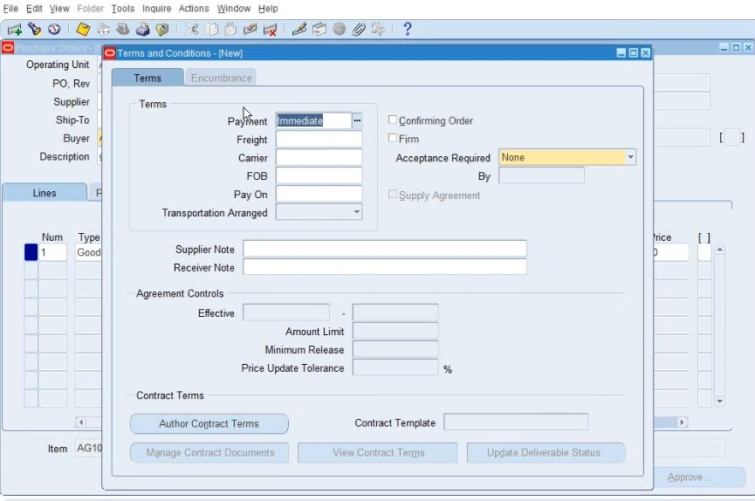
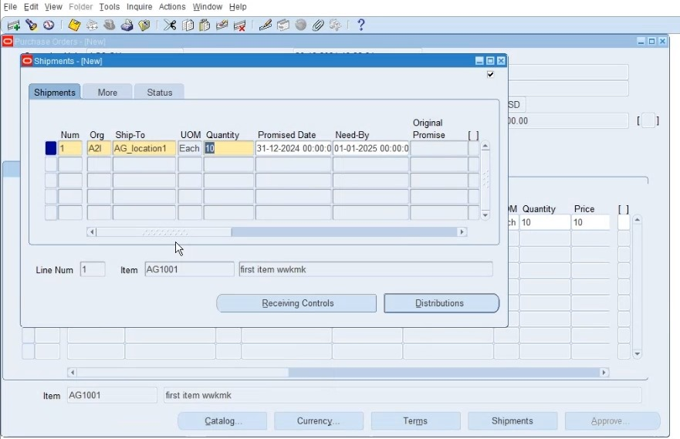
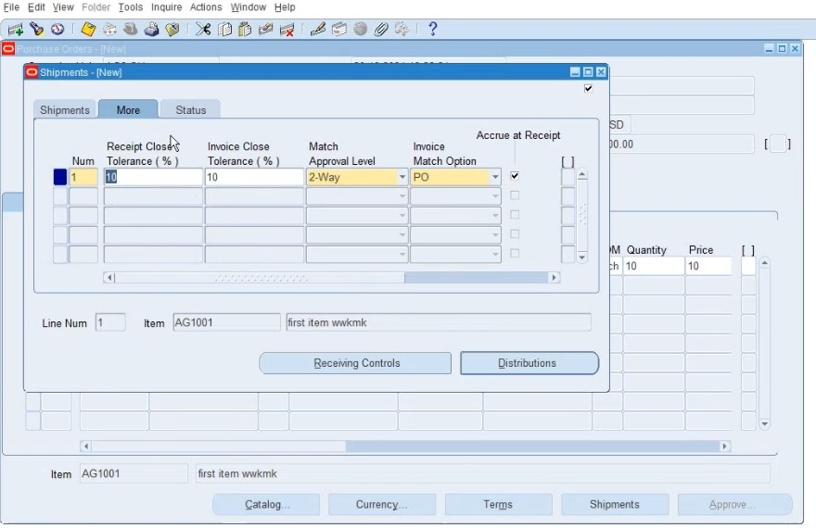
Configuration
2nd Millstone
Create Purchase Order
Direct Purchase Order
PO Terms and Conditions
Shipments
AG_Purchasing Super User (Resp.)
Purchase Order → Purchase Order

Slide 16
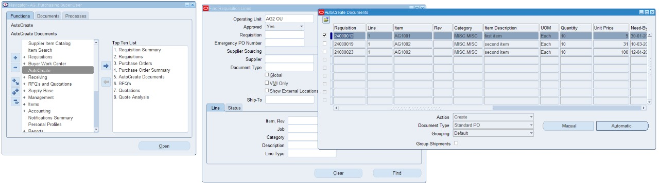
3rd Millstone
Testing and implementation
Create Purchase Order
Purchase Order from Requisition
AG_Purchasing Super User (Resp.)
Auto Create → Find → Auto create documents

Slide 17
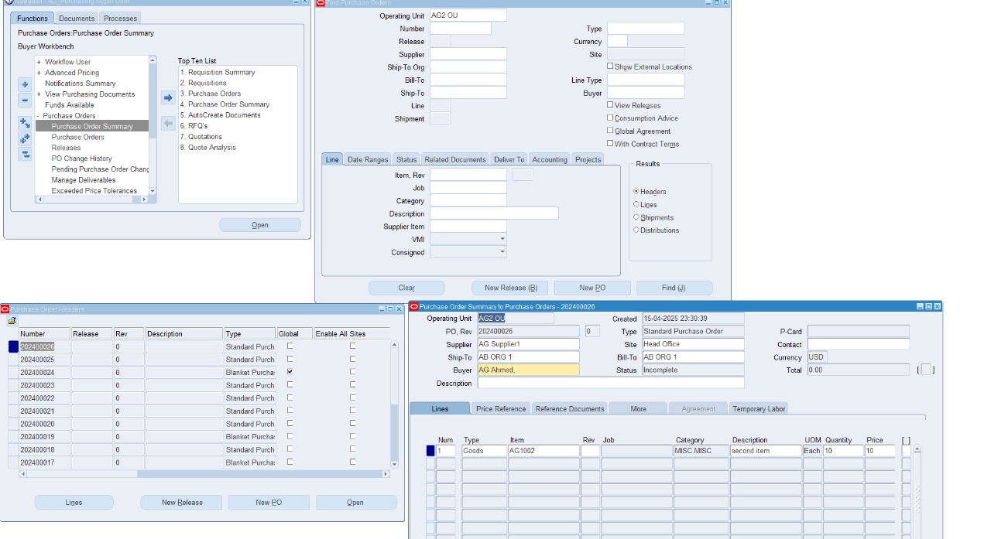
3rd Millstone
Testing and implementation
Purchase Order Summary
AG_Purchasing Super User (Resp.)
Purchase Orders → Purchase order summary

Slide 18
3rd Millstone
Testing and implementation
Blanket Agreement

Slide 19
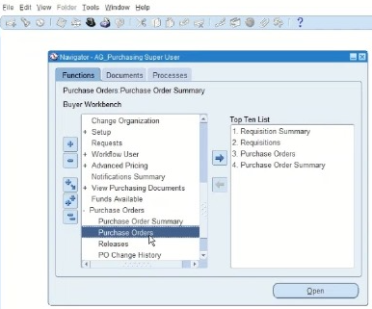
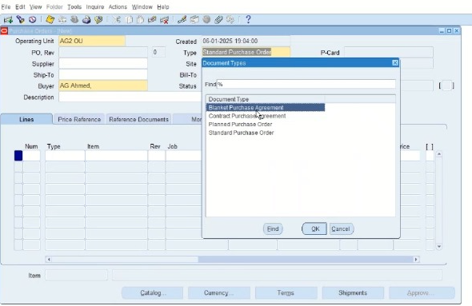
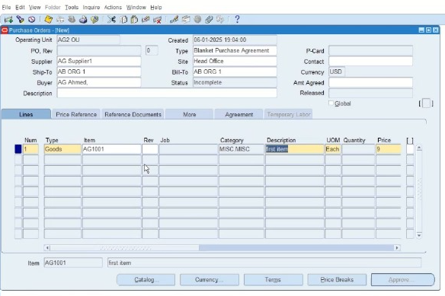
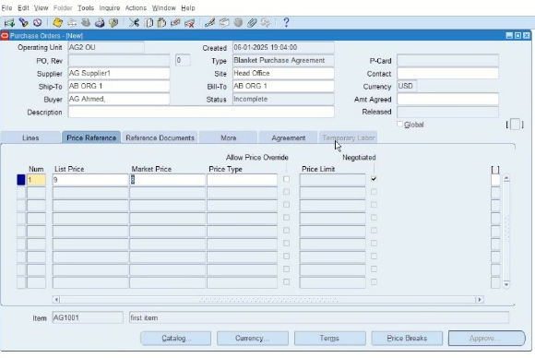
3rd Millstone
Testing and implementation
Create blanket Agreement
AG_Purchasing Super User (Resp.)
Purchase order → Purchase Order

Slide 20
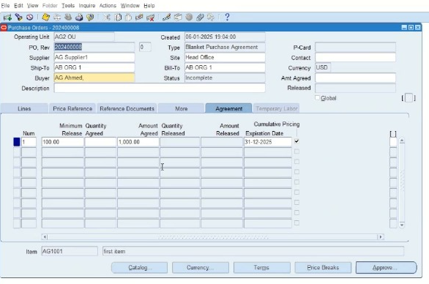
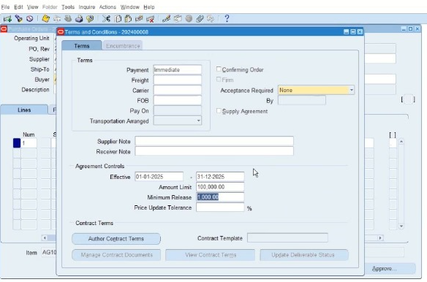
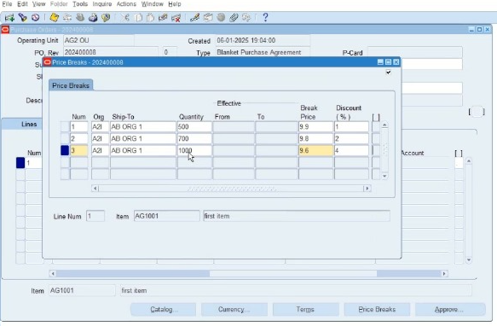
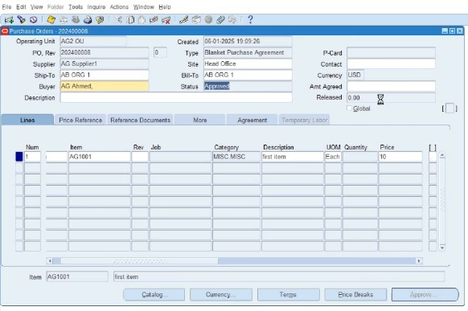
3rd Millstone
Testing and implementation
Create blanket Agreement
Terms of Agreement
AG_Purchasing Super User (Resp.)
Purchase order → Purchase Order
Price breaks
Approve Blanket Agreement

Slide 21
3rd Millstone
Testing and implementation
Blanket Agreement Release

Slide 22
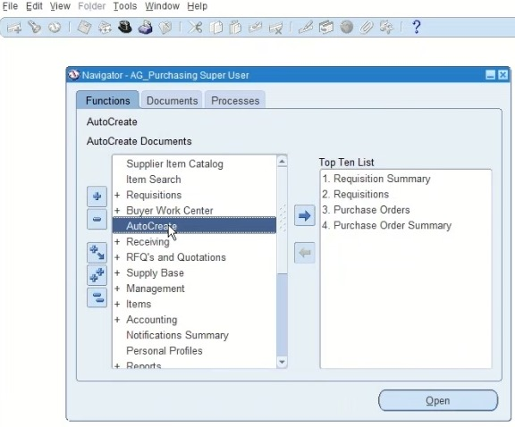
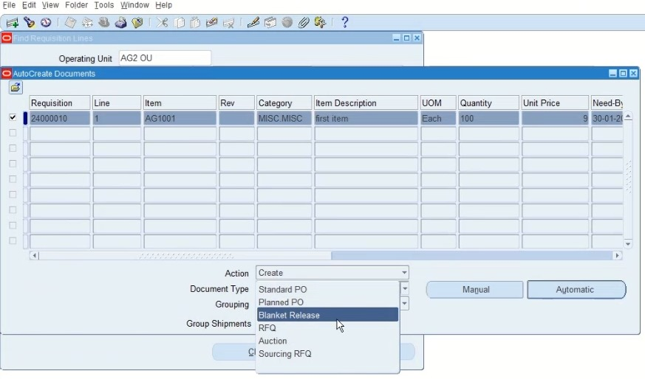
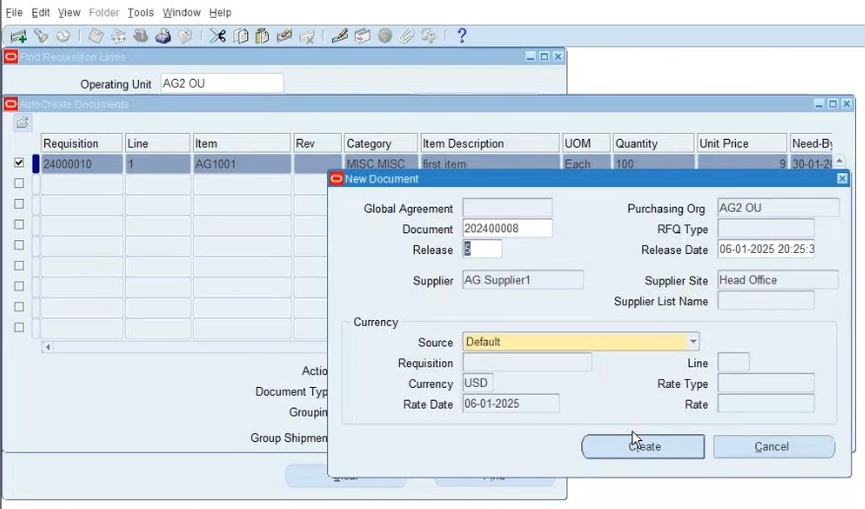
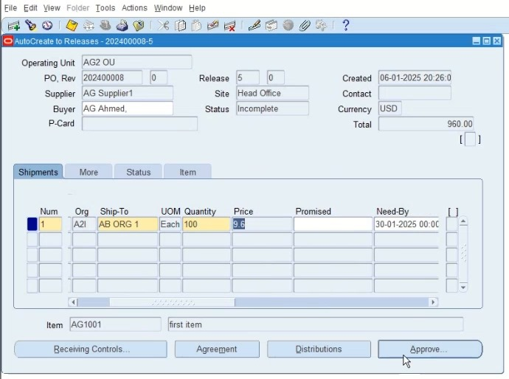
3rd Millstone
Testing and implementation
Blanket Release
From PR auto create
AG_Purchasing Super User (Resp.)
Auto Create

Slide 23
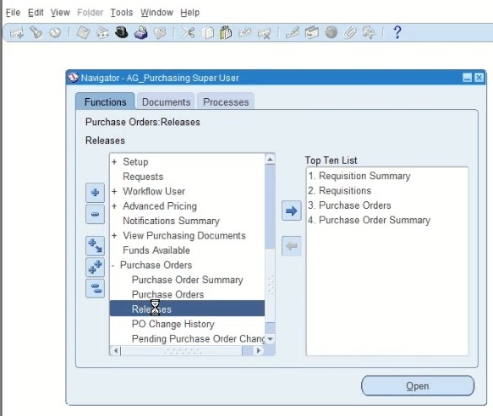
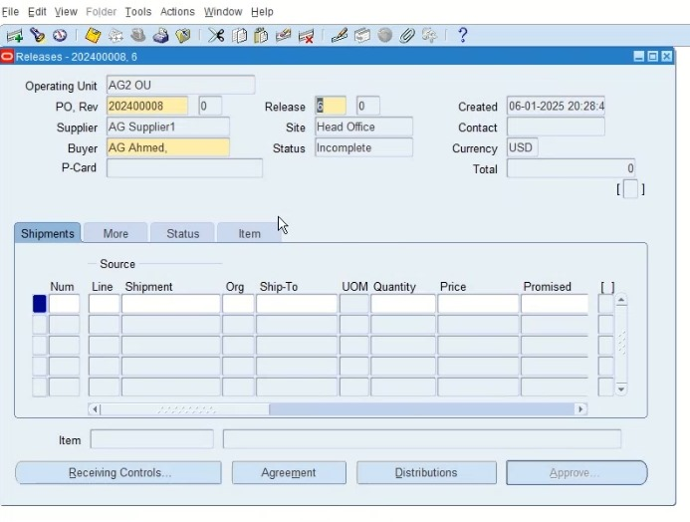
3rd Millstone
Testing and implementation
Blanket Release
From PO No. Release
AG_Purchasing Super User (Resp.)
Purchase order → Release

Slide 24
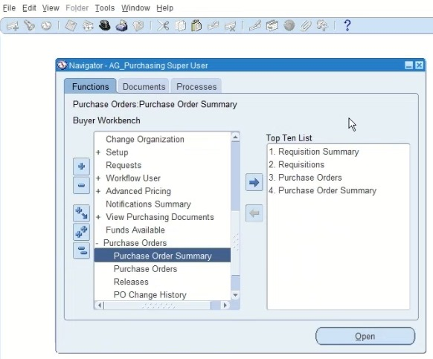
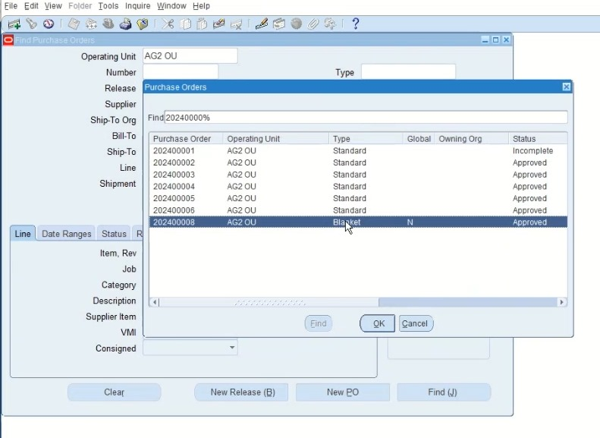
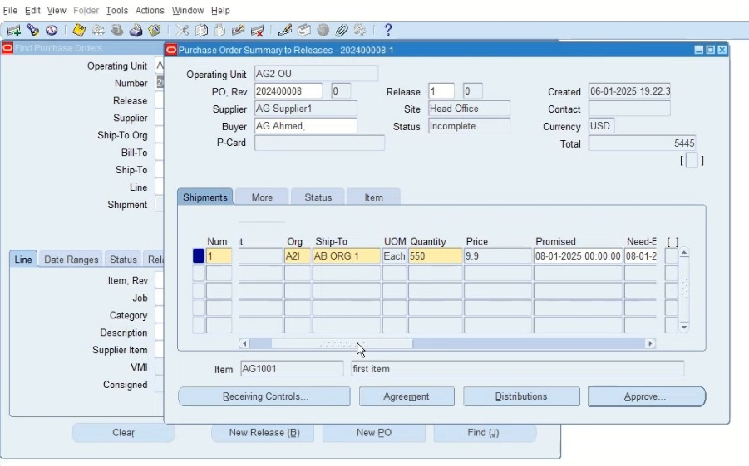
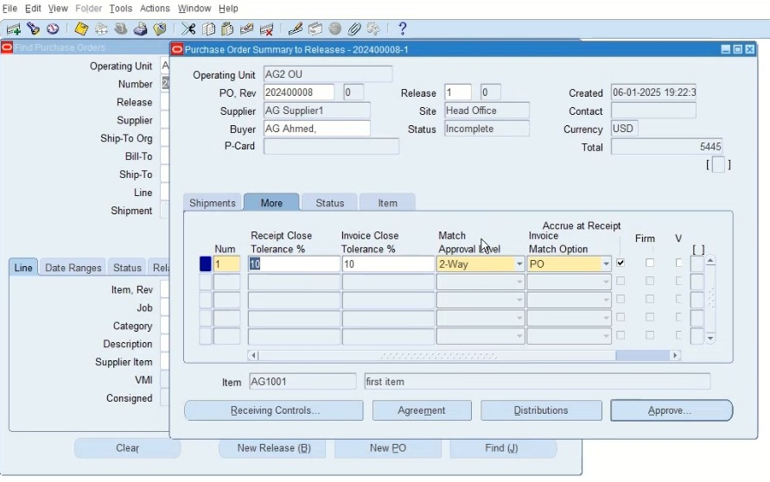
3rd Millstone
Testing and implementation
Blanket Agreement Release
From Purchase Order Summary
AG_Purchasing Super User (Resp.)
Purchase order → Purchase Order Summary

Slide 25
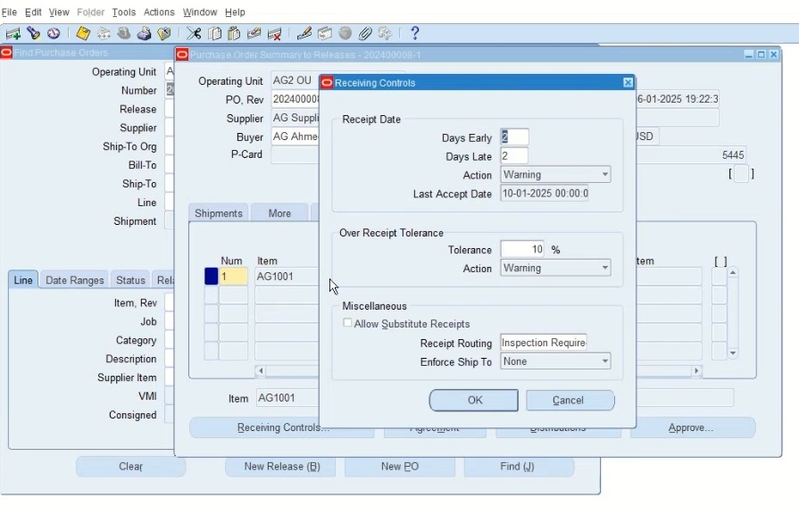
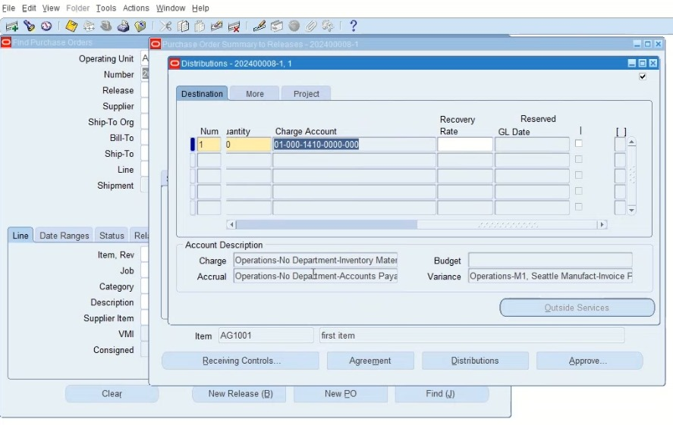
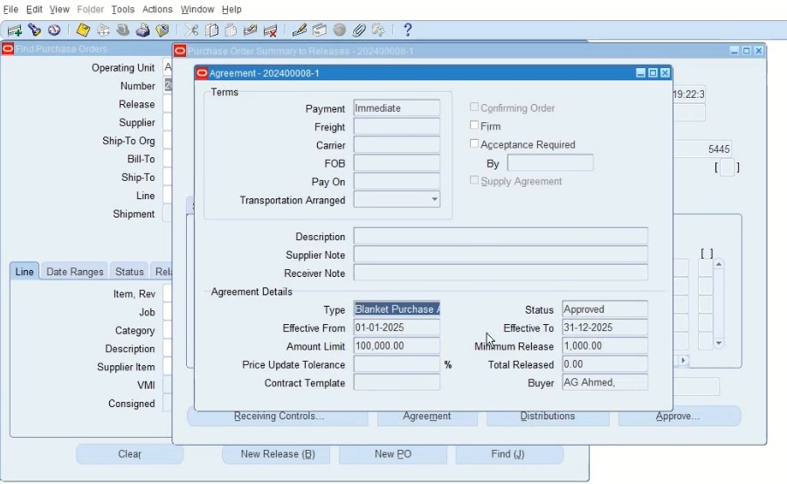
3rd Millstone
Testing and implementation
Blanket Agreement Release (Controls)
Receiving Control
Distributions
AG_Purchasing Super User (Resp.)
Purchase order → Purchase Order Summary
Agreement

Slide 26
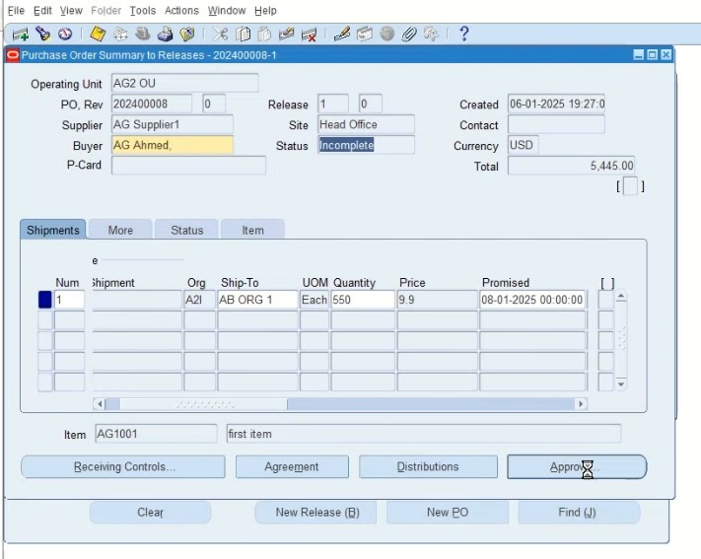
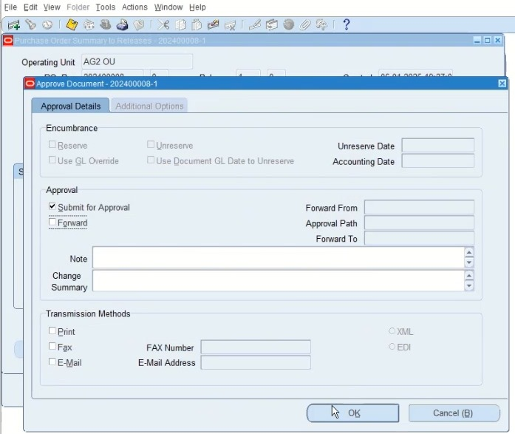
3rd Millstone
Testing and implementation
Blanket Agreement Release
Blanket Agreement Approve
AG_Purchasing Super User (Resp.)
Purchase order → Purchase Order Summary

Slide 27
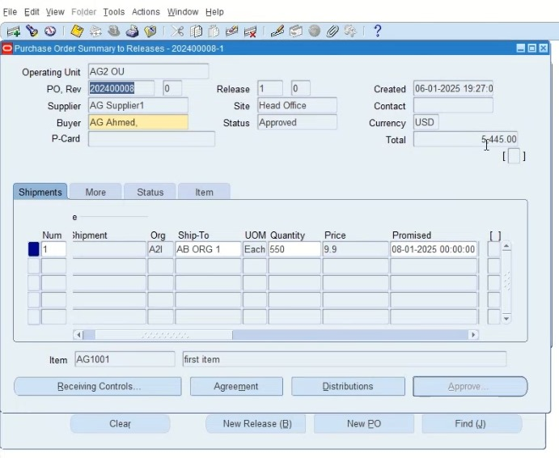
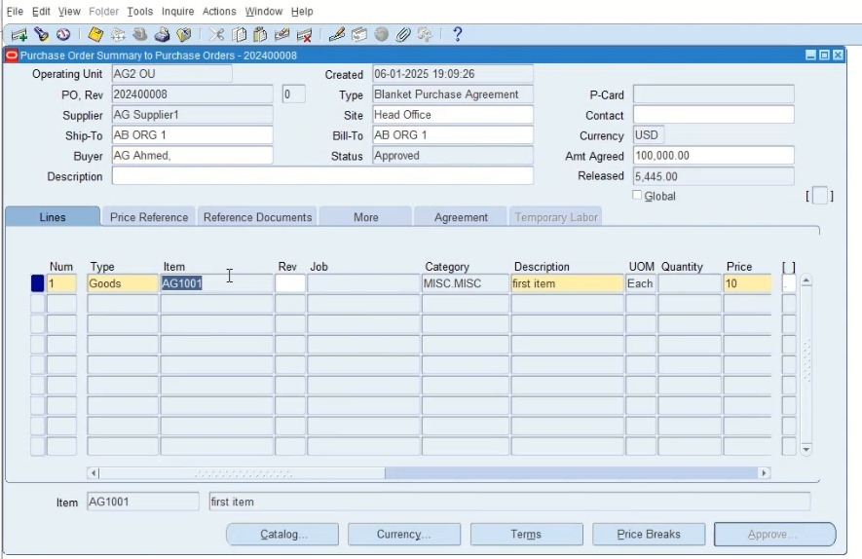
3rd Millstone
Testing and implementation
Blanket Agreement and Release Summaries:
Blanket Release Summary
PO summary - Blanket Agreement
AG_Purchasing Super User (Resp.)
Purchase order → Purchase Order Summary

Slide 28
3rd Millstone
Testing and implementation
Issuance of POs

Slide 29
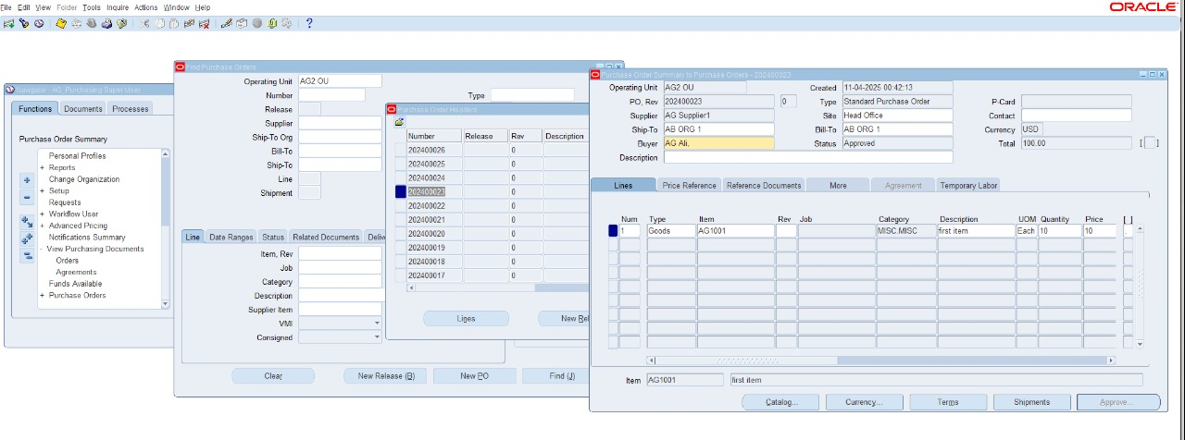
3rd Millstone
Testing and implementation
Purchase Order Issuance
AG_Purchasing Super User (Resp.)
Inquiries → view documents

Slide 30
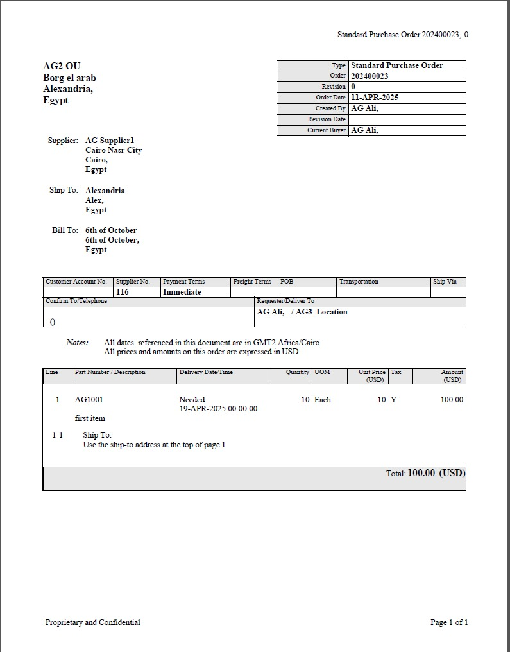
3rd Millstone
Testing and implementation
Purchase Order Issuance
AG_Purchasing Super User (Resp.)
Inquiries → view documents

Slide 31
3rd Millstone
Testing and implementation
Approved Supplier List

Slide 32
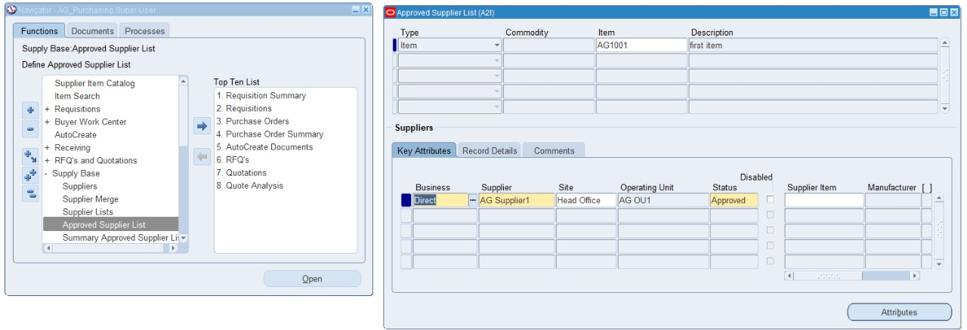
3rd Millstone
Testing and implementation
Approved Supplier List
AG_Purchasing SuperUser (Resp.)
Supply Base → Approved Supplier list

Slide 33
3rd Millstone
Testing and implementation
Supply Planning Method

Slide 34
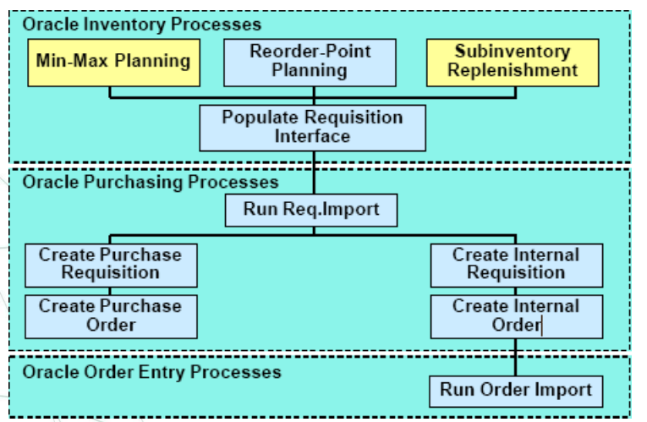
2nd Millstone
Testing and implementation
Oracle Planning Methods:
Reorder-point planning (Organization)
Min-max planning (Organization and sub inventory)
Replenishment Counting
Vendor managed
Kanban planning
Material-Requirements Planning:
Master Production Scheduling/ Master Demand Scheduling (Organization)
MIN MAX Planning

Slide 35
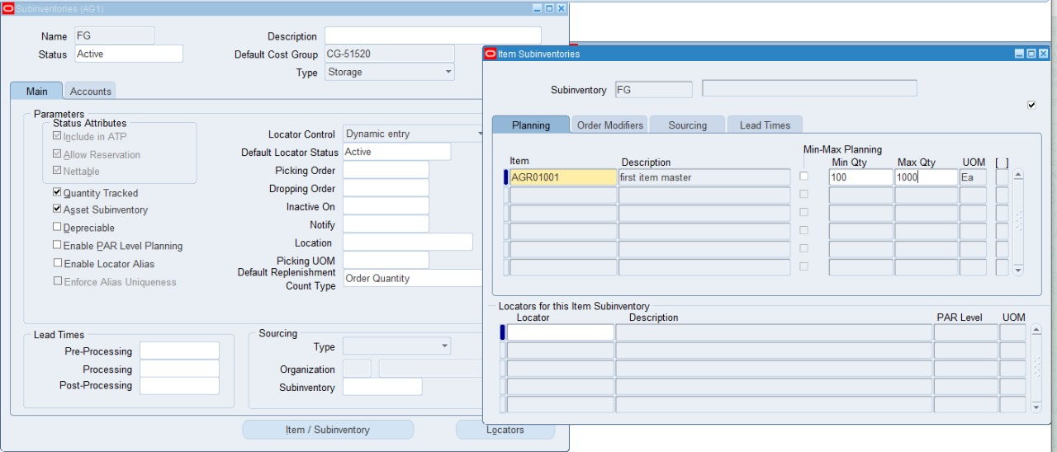
3rd Millstone
Testing and implementation
MIN-MAX Setting from Sub inventory
AG_Inventory 2 (Resp.)
Sub Inventory – MIN-MAX

Slide 36
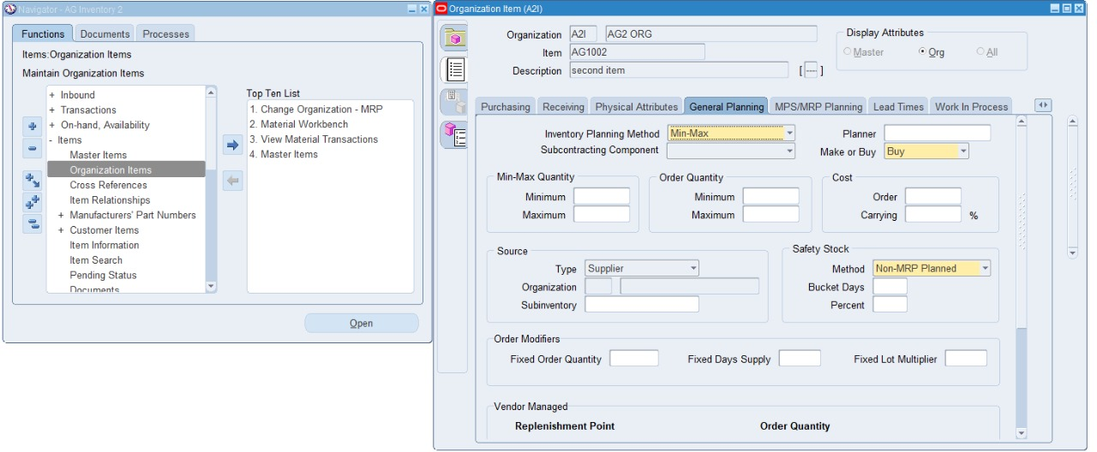
3rd Millstone
Testing and implementation
MIN-MAX Planning Method
AG Inventory 2 (Resp.)
Item → Organization Item

Slide 37
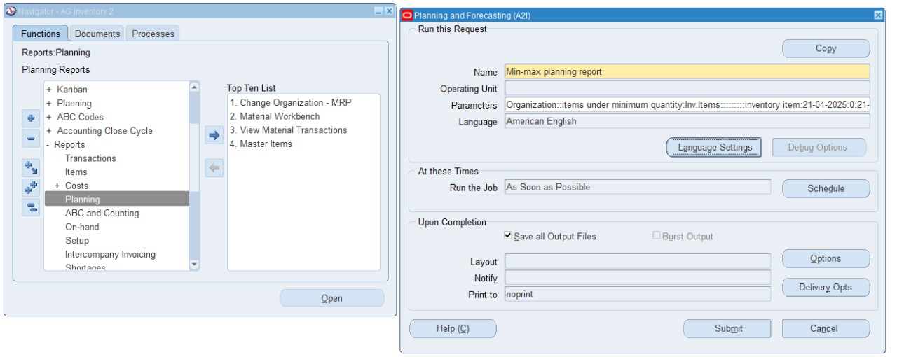
3rd Millstone
Testing and implementation
MIN-MAX Planning Method
AG_Inventory 2 (Resp.)
Planning
Run Request: Min-Max planning report

Slide 38
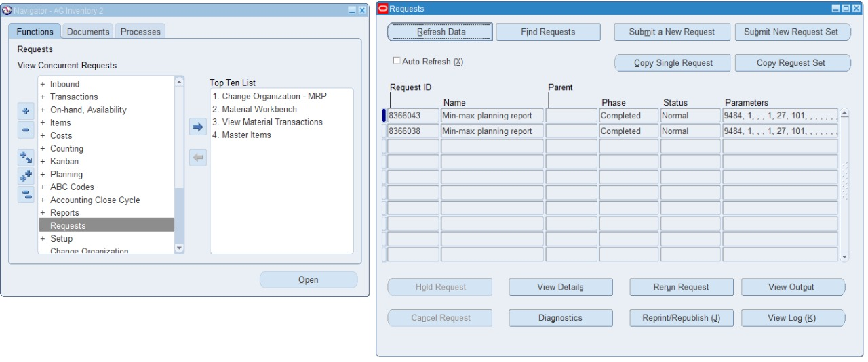
3rd Millstone
Testing and implementation
MIN-MAX Planning Method
AG Inventory 2 (Resp.)
Request

Slide 39
3rd Millstone
Testing and implementation
Material Receipt

Slide 40
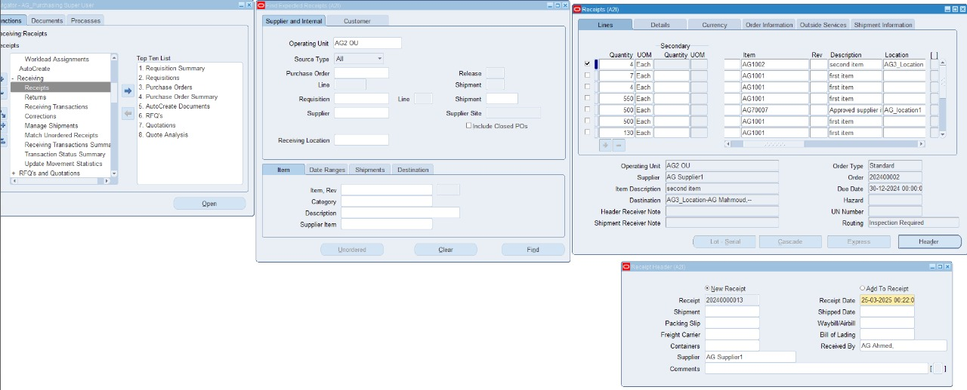
3rd Millstone
Testing and implementation
Material Receipts
1st step: Receipt
An auto request generated after saving of receipt date
Request name: Receiving transaction processor
AG_Purchasing Super User (Resp.)
Receiving → Receipts

Slide 41
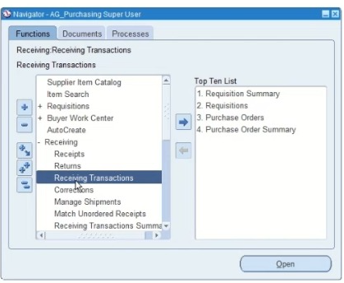
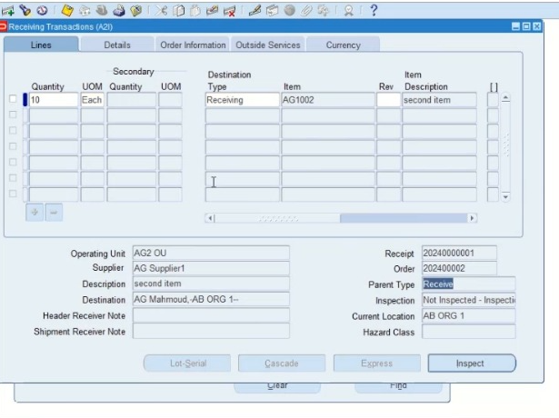


3rd Millstone
Testing and implementation
Material Receipts
2nd Step: Inspection
AG_Purchasing Super User (Resp.)
Receiving → Receiving Transactions

Slide 42


3rd Millstone
Testing and implementation
Material Receipts
3rd Step: Deliver to sub-Inventory
AG_Purchasing Super User (Resp.)
Receiving → Receiving Transactions

Slide 43


3rd Millstone
Testing and implementation
Material Return
Return to supplier
AG_Purchasing Super User (Resp.)
Receiving → return

Slide 44




3rd Millstone
Testing and implementation
Material Receipts (Without PO)
Receive without PO
1st step receive unorder receipt
AG_Purchasing Super User (Resp.)
Receiving → receipt
Condition of receipt
Allow unordered receipt (Item - Supplier –Receiving option)

Slide 45



3rd Millstone
Testing and implementation
Material Receipts (Without PO)
Receive without PO:
2nd step Matching With PO
AG_Purchasing Super User (Resp.)
Receiving → Match unordered receipt

Slide 46
4th Millstone
Training
01
Provide training to end-users and administrators for effective use of the module.
Learning Material and Videos Link
Metwally-Ibrahim/NXT21__ALX2_ERP_G1_Proj_1

Slide 47




Thanks

